Slide 1
Adrenal Cortical Disorders
Dr Madunil A Niriella
Department of Medicine

Slide 2
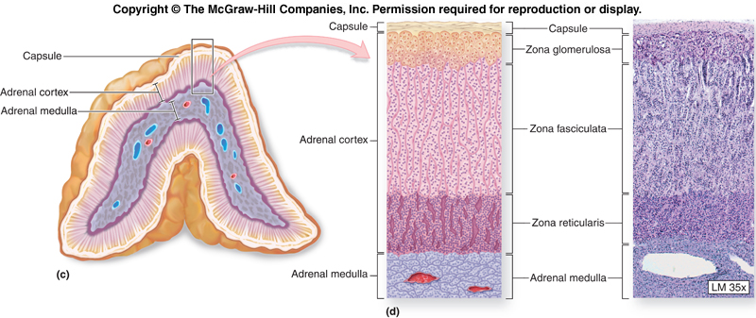
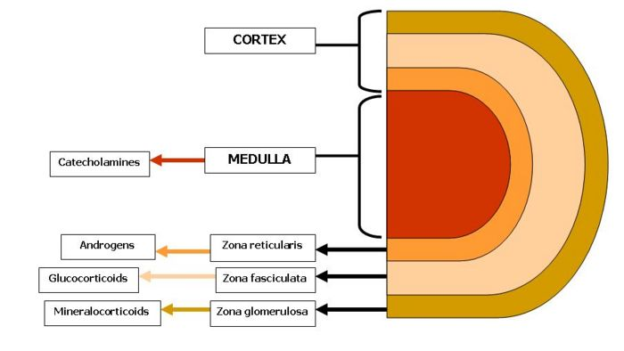

Slide 3
Primary Hypoadrenalism – Addison Disease

Slide 4
Destruction of adrenal cortex
↓ Cortisol → ↑ CRH & ACTH
Rare – incidence 3-4/million/year prevalence 40-60/million
Females > Males

Slide 5
Causes
Autoimmune disease
Tuberculosis
Surgical removal of adrenals (adrenalectomy)
Haemorrhage / Infarction – meningococcal septicaemia
Infiltration
Adrenal leucodystrophy

Slide 6
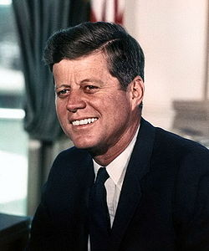
Symptoms
Vague & non-specific - malaise, weakness
Pigmentation (in >90%)
Postural hypotension (in >80%) → pre-syncope and syncope
LOA & LOW
Depression
Nausea, vomiting, diarrhoea
Impotence, amenorrhoea

Slide 7
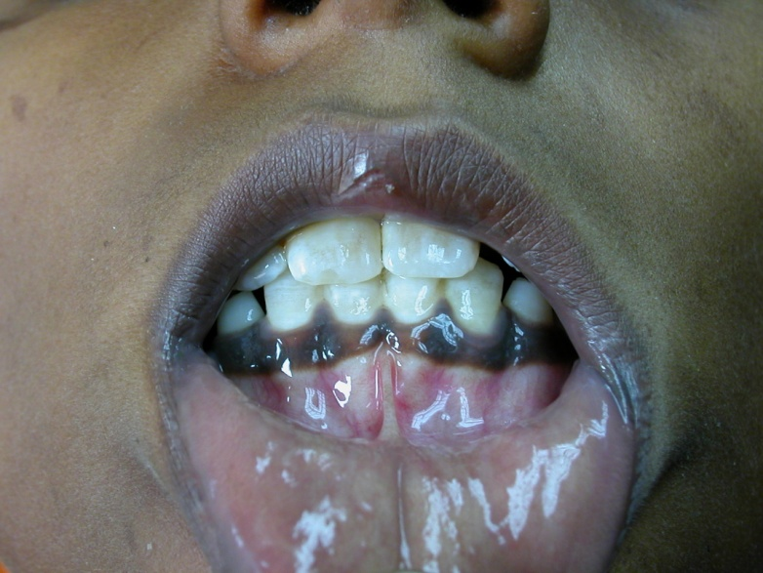
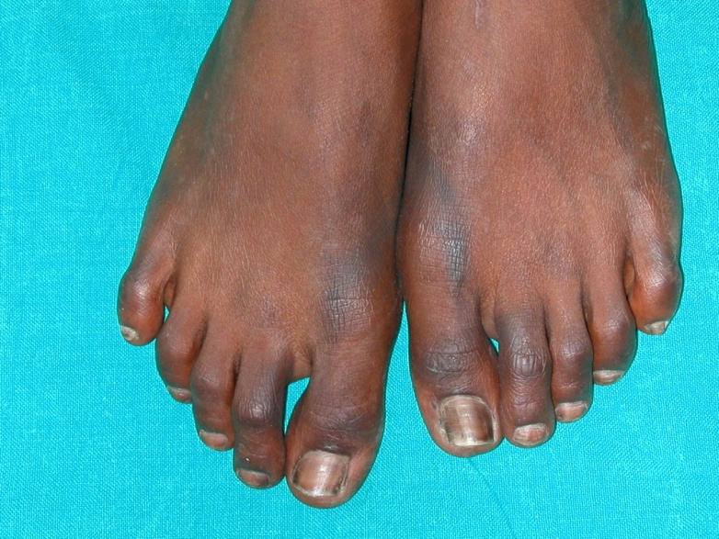
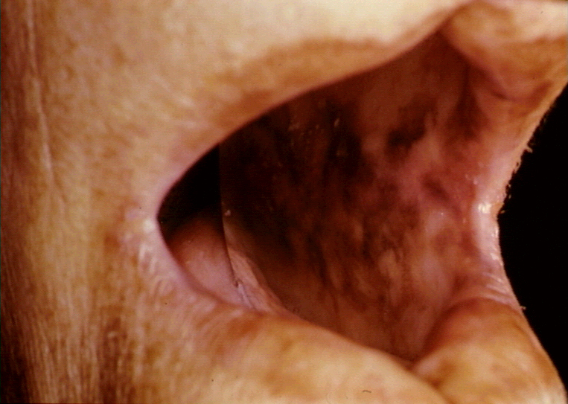
Signs
Pigmentation –
new scars
palmar creases
buccal
Postural hypotension
LOW and generalised wasting
Dehydration
Loss of body hair
Vitiligo

Slide 8
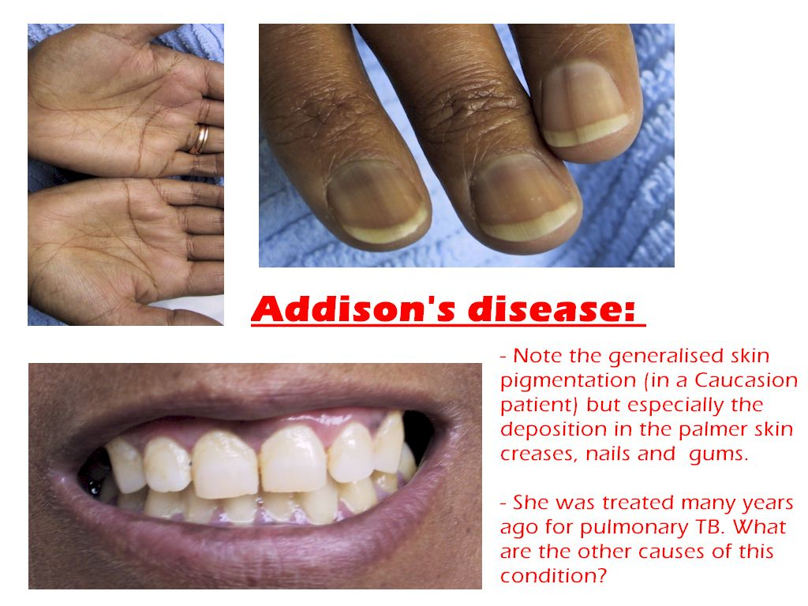

Slide 9
Addisonian Crisis
Precipitated by intercurrent illness, trauma, surgery, etc
Life threatening – medical emergency
Salt, steroid & glucose deficiency
Severe dehydration
Hypotension
Hypoglycaemia

Slide 10
Investigations
Random cortisol – of little value
If <100 nmol/L during day → highly suggestive
If >550 nmol/L → unlikely
Short ACTH stimulation test –
Tetracosactide 250 microg i.v/im at 0 mins
Plasma cortisol at 0 & 30 mins
If cortisol at 30 mins is >600 nmol/L → excludes primary adrenal failure
9 am plasma ACTH –
If high with low/low normal cortisol → confirms primary adrenal failure

Slide 11
Investigations
Long ACTH stimulation test – rarely used now
Depot tetracosactide i.m at time 0
Plasma cortisol serially for 24 hrs
Maximum >1000 nmol/L or rise >550 nmol/L
Detects adrenal suppression
↑ potassium & urea, ↓ sodium
↓ glucose
↓ aldosterone, ↑ renin
↑ calcium
Anaemia
Adrenal Abs
Chest & Abdo Xrays for TB

Slide 12
Treatment – Acute Hypoadrenalism
N. saline + Hydrocortisone i.v
Glucose iv
Oral steroids once stable
Fludrocortisone later

Slide 13
Treatment – Long Term
Treat underlying cause if possible – TB
Replacement with
(a) Glucocorticoid – hydrocortisone
- prednisolone
(b) Mineralocarticoid - fludrocortisone

Slide 14
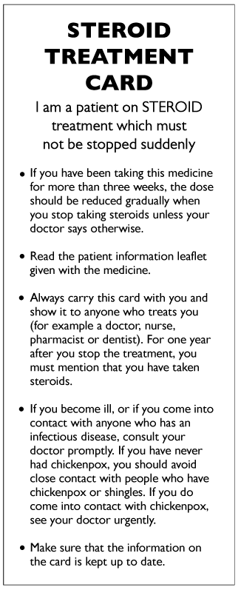

All patients on steroid replacement should -
Know how to increase steroid dose for inter-current illness
Carry a ‘steroid card’
Have vial of iv hydrocortisone with them

Slide 15
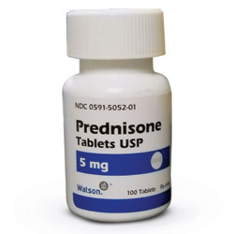
Secondary Hypoadrenalism
Hypothalamic-pituitary disease
→ inadequate ACTH production
Long term steroid therapy
→ hypothalamic-pituitary-adrenal suppression
Common
Long ACTH stimulation test
Slowly wean off steroids

Slide 16
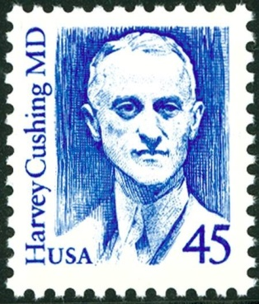
Cushing Syndrome

Slide 17
Increased free circulating glucocorticoid
Commonly due to therapeutic synthetic steroids (or ACTH) administration
All spontaneous forms are rare
< 5/million/year

Slide 18
Causes
ACTH-dependant
Pituitary-dependant (Cushing’s disease) 65%
Ectopic ACTH-producing tumours 10%
ACTH administration
Non-ACTH-dependant 25%
Adrenal adenoma
Adrenal carcinoma Glucocorticoid administration
Alcohol-induced
Pseudo-Cushing’s syndrome

Slide 19
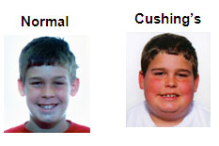
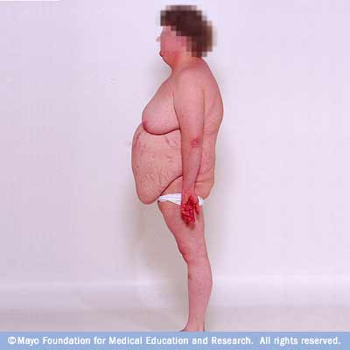
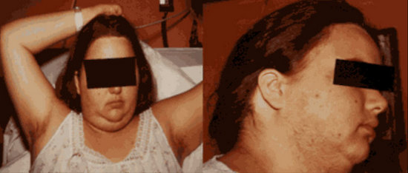
Symptoms
Weight gain, change in appearance
Insomnia
Depression
Psychosis
Amenorrhoea/oligomenorrhoea
Poor libido
Polyuria, polydipsia

Slide 20
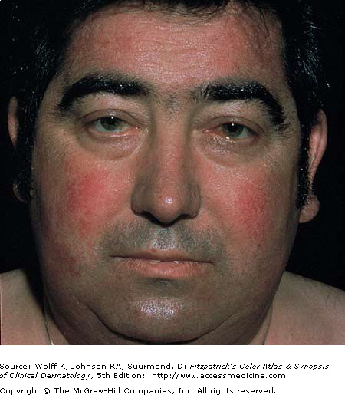
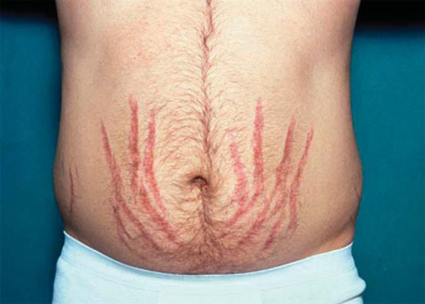
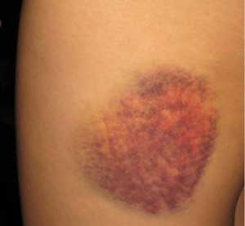
Signs - Discriminatory
Plethora
Thin skin
Easy bruising
Hypertension
Pathological fractures
vertebrae, ribs
Striae – purple/red
Proximal myopathy

Slide 21
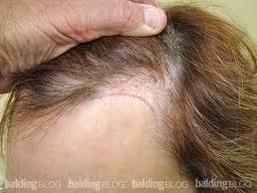
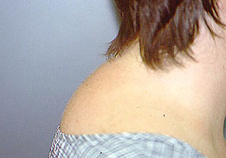
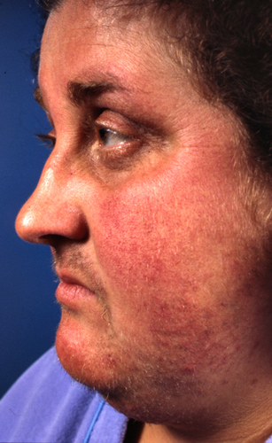
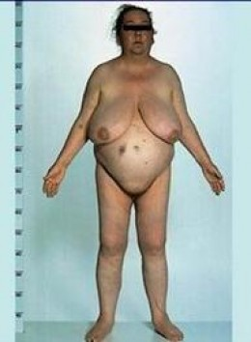
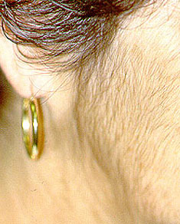
Signs
Moon face
Buffalo hump
Central obesity
Acne
Hirsuitism
Frontal balding (females)
Osteoporosis
Oedema
Glycosuria

Slide 22

Other Clinical Features
Pigmentation
only in ACTH-dependant causes
Cushingoid appearance
in excess alcohol consumption
IGT or Diabetes mellitus
ectopic ACTH
Hypokalaemia
ectopic ACTH

Slide 23
MOST obese, hirsute & hypertensive patients do NOT have Cushing’s syndrome
Obesity & depression alter cortisol dynamics in normal people
Random cortisol – useless
‘Cyclical Cushing’s’

Slide 24
Confirming Diagnosis
Overnight dexamethasone suppression test – 1 mg at 11 pm – cortisol at 9 am
normal <100 nmol/L
outpatient screening
false positivity
48-hour low-dose dexamethasone suppression test –
0.5 mg qds
9 am plasma cortisol at 0 & D2
normal <50 nmol/L on D2
highly sensitive

Slide 25
Confirming Diagnosis
24-hour urinary free cortisol
simple but less reliable
Circadian variation
cortisol at 9 am & 11 pm
Cushings – high midnight level
Specialist tests
Insulin stress
Desmopressin stimulation
CRH

Slide 26
Differential Diagnosis of Cause
All causes → clinically identical Cushing’s syndrome
Ectopic ACTH – short history
pigmentation
LOW
low potassium
DM
high plasma ACTH
Adrenal tumour – severe hirsutism & virilization

Slide 27
Differential Diagnosis of Cause
Adrenal CT or MRI –
tumours are large
bilateral adrenal hyperplasia → ACTH-dependant
ACTH-independant nodular hyperplasia
Pituitary MRI
Plasma potassium – ectopic ACTH
High-dose dexamethasone suppression test – 2 mg qds
9 am plasma cortisol at 0 & D2
Suppression → pituitary disease
No significant suppression → ectopic ACTH
adrenal tumour

Slide 28
Differential Diagnosis of Cause
Plasma ACTH
if low → non-ACTH dependant disease
CRH test
exaggerated response → pituitary-dependant
Chest X-ray
bronchial CA or carcinoid
Selective catheterization of inferior petrosal sinus, to measure ACTH level (pituitary-dependant)
Blood samples from whole body (ectopic)
Radiolabelled octreotide (ectopic)

Slide 29
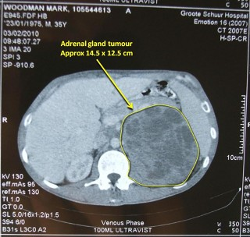
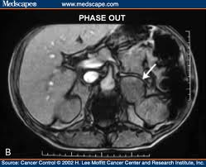
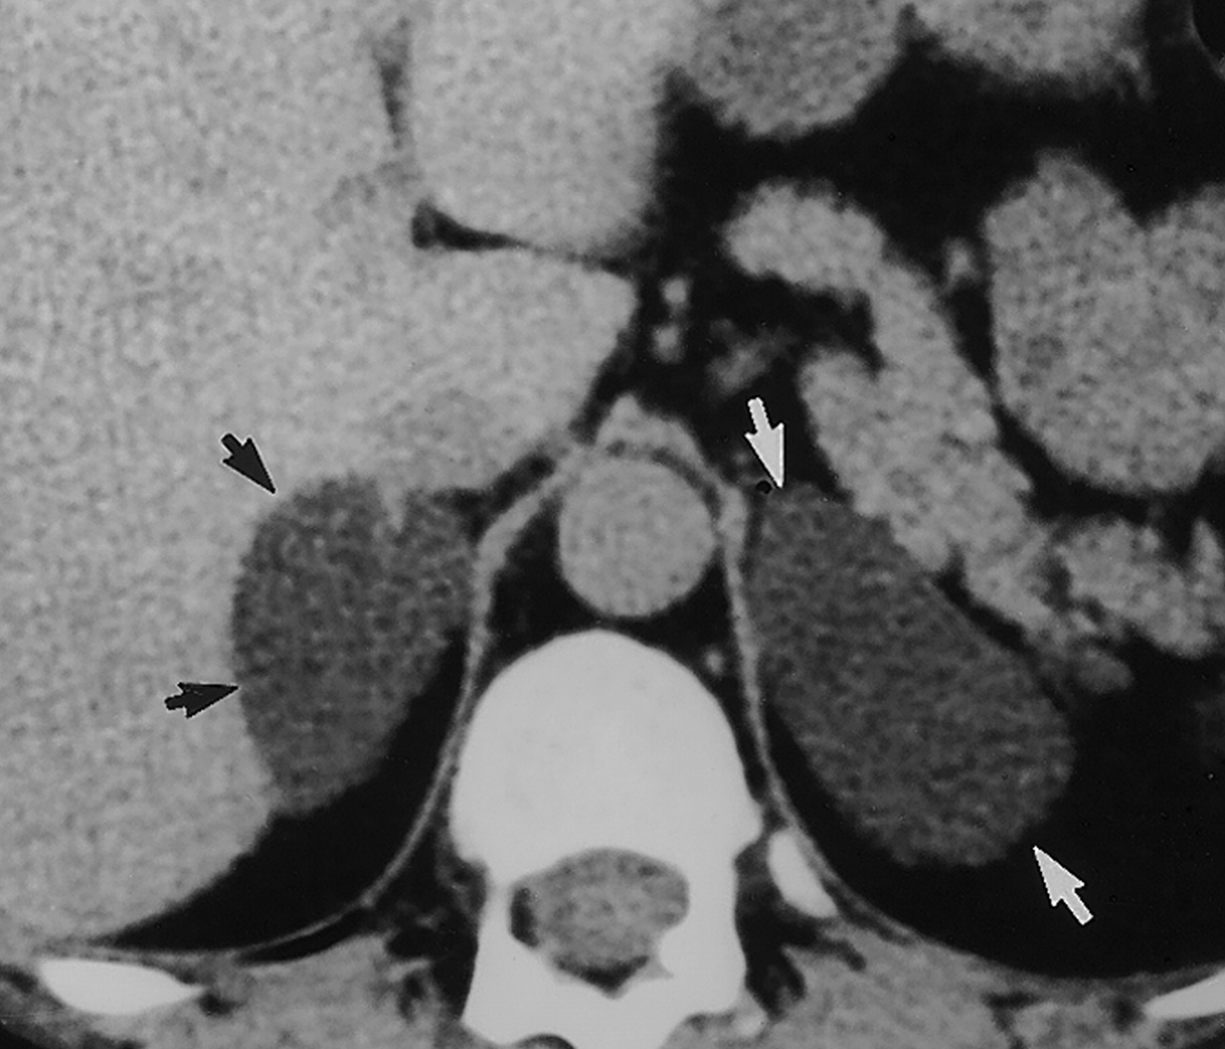
Imaging of adrenal glands

Slide 30
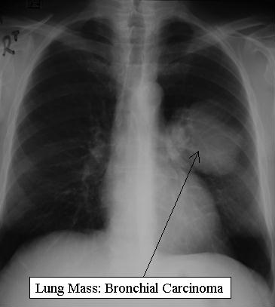
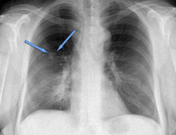
Chest X-ray

Slide 31
Treatment
Untreated → bad prognosis
Cortisol hypersecretion MUST be controlled prior to surgery or radiotherapy
Using Metyrapone (11β-hydroxylase blocker) with Ketoconazole synergistically

Slide 32
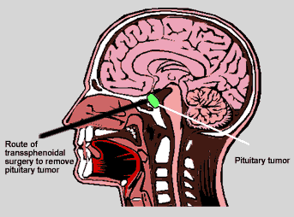
Treatment of Pituitary-Dependent Hyperadrenalism (Cushing Disease)
Trans-sphenoidal tumour removal
best with remission in 75-80%
External pituitary irradiation
mainly used after failed pituitary surgery
Medical therapy
rarely effective
Bromocriptine, Cyproheptadine
Bilateral adrenalectomy
last resort

Slide 33
Treatment of Hyperadrenalism
Adrenal Adenoma
resection
Adrenal Carcinoma
aggressive → poor prognosis
surgical reduction of tumour bulk
chemotherapy (mitotane)
radiotherapy
Tumours secreting ACTH ectopically
surgical removal if possible
chemo & radio-therapy
bilateral adrenalectomy

Slide 34
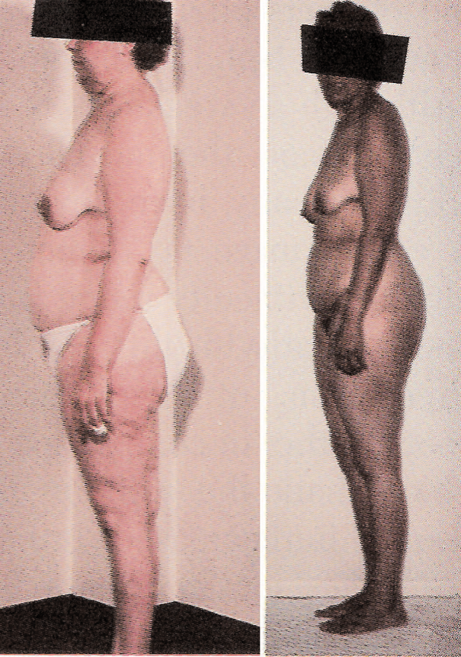
Nelson’s Syndrome
Increased pigmentation (↑ ACTH) due to enlarging pituitary tumour
In 20% after bilateral adrenalectomy for Cushing’s Disease
Rare
Surgery or radiotherapy

Slide 35
Disorders of Aldosterone Secretion

Slide 36
Aldosterone
Mineralocorticoid
Produced in adrenal cortex
Acts on distal renal tubule
Maintains sodium & potassium balance in ECF

Slide 37
Primary Hyperaldosteronism
Sodium retention
Potassium loss → hypokalaemia
Adrenal adenoma (Conn’s syndrome)
young woman
Bilateral adrenal hyperplasia
older men
Severe (secondary) hypertension (accounts for 5-10% of all hypertension)
Non-specific symptoms
muscle weakness, nocturia, tetany

Slide 38
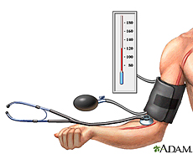
Management
Investigations –
Plasma aldosterone:renin ratio
↑ plasma aldosterone
↓ plasma renin
hypokalaemia
increased urinary K loss
Treatment –
surgical resection
spironolactone (aldosterone antagonist)

Slide 39
Secondary Hyperaldosteronism
With hypertension –
accelerated hypertension
renal artery stenosis
Without hypertension –
congestive cardiac failure
cirrhosis
Useful drugs → ACEI
ARB
Spironolactone

Slide 40
Phaeochromocytoma

Slide 41
Catecholamines - produced in adrenal medulla
Noradrenaline (norepinephrine)
Adrenaline (epinephrine)
Play a part in BP control

Slide 42
Pheochromocytoma are v rare
Tumours of sympathetic nervous system
90% in adrenals
25% multiple
10% malignant
Associations - MEN II
von Hippel Lindau syndrome

Slide 43

Symptoms
May be intermittent
Anxiety, panic attacks
Palpitations, tremors
Headache
Sweating, flushing
Nausea, vomiting
Weight loss
Constipation or diarrhoea
Chest pain

Slide 44

Signs
Hypertension
Tachycardia/bradycardia/arrhythmias
Orthostatic hypotension
Pallor or flushing
Glycosuria
Fever

Slide 45
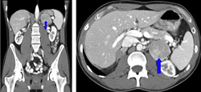
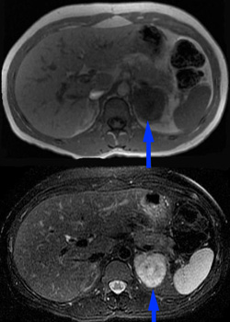
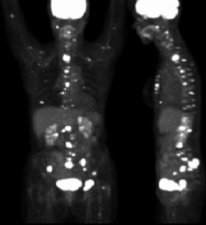
Investigations
Measurement of urinary
catecholamines (metanephrine)
Resting plasma
catecholamines
CT or MRI
abdomen
mIBG scan

Slide 46
Treatment
Ideally surgical resection
Pre-op
complete alpha blockade (phenoxybenzamine)
then beta blockade (Propranolol)
blood transfusion
If surgery is not possible → combined
alpha & beta blockade long term

